Slide 1
Digital Photo Printing

Slide 2
Agenda
TEAM INTRODUCTION
PROBLEM STATEMENT
WORK DIVISION
TOOL USED
EXPERIENCE

Slide 3
Team introduction
Syed Muhammad Shah
Rajab Shaikh
Wali Shah
Rizwan Shaikh
Muhammad Jawad

Slide 4
PROBLEM STATEMENT
“My Image” is a group of people who wants to develop an online site were the user can upload his or her photographs and can order them for printing. A customer can have a set of digital photographs in his desktop which he/she wants to print. He/she can provide the application the path to the folder where the photographs are stored and can choose the photos that he/she wants to print and choose the size of the prints. The application will calculate the price after downloading the price information from the database for the different print sizes and show it to the user. The user will enter his/her credit card/other payment option (or choose any other mode of payment) and shipping information if he/she wants to go ahead with the order. If the credit card information is found correct, the photos are uploaded to the server and a purchase order is created in the database.

Slide 5
work DIVISION
Data Collection
Implementation
Rizwan Shaikh
Muhammad Jawad
Syed Muhammad Shah
Muhammad Sami
Prototype
Designing
Documentation
Syed Muhammad Shah
Muhammad Sami
Syed Muhammad Shah
Wali Shah
Wali Shah
Muhammad Sami

Slide 6
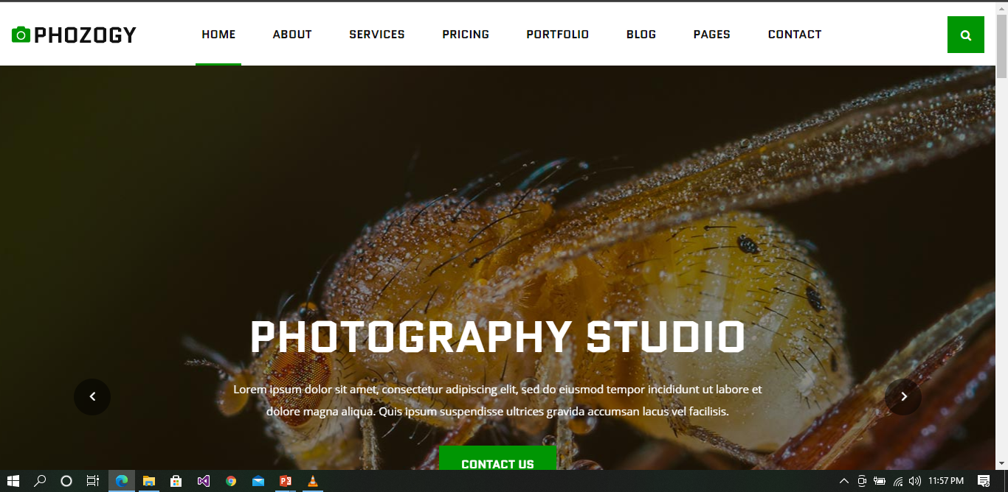
TOOL USED
ASP.NET
SQL
FRAME WORK
MVC
Place your screenshot here

Slide 7
EXPERIENCE
This is a good opportunity to attend e-project to polish
our skills. And ready to step-in in the professional life
and face actual difficulties this is the best way to
experience.
We would like to express our special thanks of gratitude
To e-project team and Aptech to give us an opportunity to
improve our skills. We would like to extend our gratitude
to Miss Samreen Rafiq who clear our
difficulties and helps us to complete our project on
time. ALHUMDULILLAH!

Slide 8
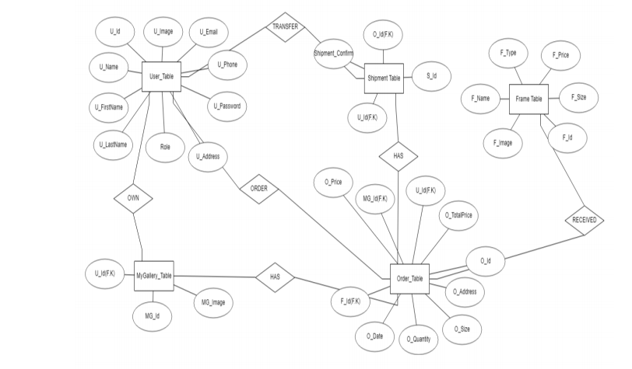
entity relationship diagram

Slide 9
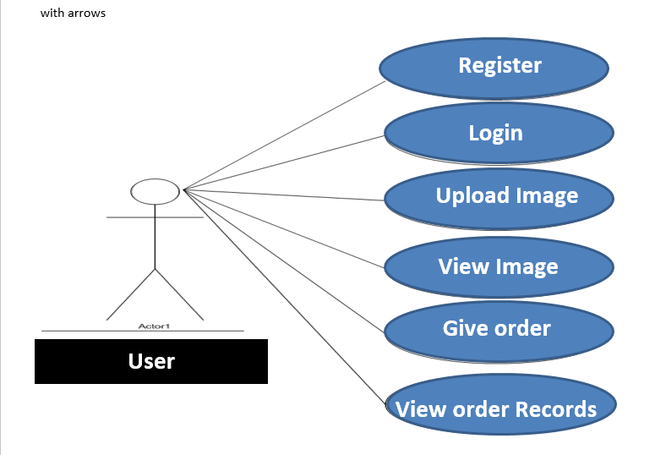
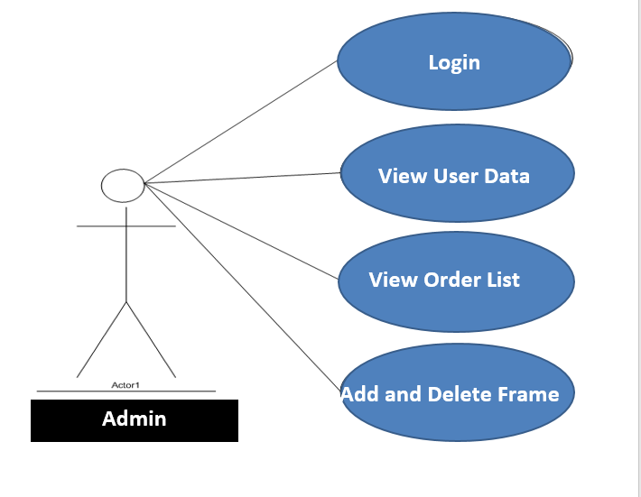
use case diagram

Slide 10
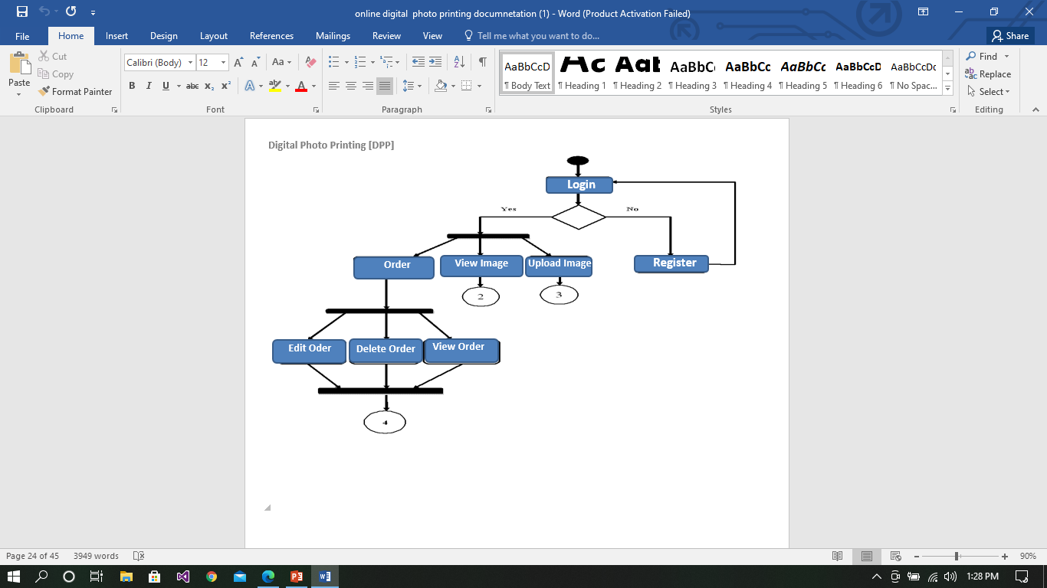
diagram

Slide 11
thanks!
syedmoon2000@gmail.com
Any questions?

